Slide 1


Wilna Coronado
August 6, 2024

Slide 2

Outline
Executive Summary
Introduction
Methodology
Results
Conclusion

Slide 3
Executive Summary
Summary of methodologies
Data Collection through API
Data Collection with Web Scraping
Data Wrangling
Exploratory Data Analysis with SQL
Exploratory Data Analysis with Data Visualization
Interactive Visual Analytics with Folium
Machine Learning Prediction
Summary of all results
Exploratory Data Analysis result
Interactive analytics in screenshots
Predictive Analytics result

Slide 4
Introduction
Project Background and Context
SpaceX’s Falcon 9 rocket has revolutionized the aerospace industry with its reusable first stage, resulting in significant reductions in launch costs. While SpaceX offers launches at $62 million, other providers charge upwards of $165 million. The key to SpaceX’s cost efficiency lies in the reusability of the Falcon 9’s first stage. By determining whether the first stage will successfully land, we can ascertain the launch price. Public data and machine learning models can help predict whether SpaceX or a competing company can reuse the first stage. Understanding the factors influencing the successful landing of the Falcon 9 first stage can yield valuable insights for competitors and industry stakeholders.
Problems to Address
What factors determine if the rocket will land successfully?
Can we accurately predict the successful landing of the Falcon 9 first stage using historical data?
How does the prediction of landing success translate into cost savings for rocket launches?

Slide 5

Section 1

Slide 6
Methodology
Executive Summary
Collect data using SpaceX API and web scraping from Wikipedia.
Perform Data Wrangling by applying One Hot Encoding to the data fields for machine learning, remove any irrelevant columns and handled missing values.
Explore the data using SQL and data visualization techniques.
Create visualizations using Folium and Plotly Dash.
Construct classification models to predict landing outcomes and fine-tune and evaluate the models to identify the best parameters.

Slide 7
Data Collection
In our data collection process, we utilized two primary sources:
SpaceX REST API:
We accessed SpaceX launch data directly from the SpaceX REST API.
This API provides comprehensive information about launches, including details about the rocket used, payload delivered, launch specifications, landing specifications, and landing outcomes.
Our objective is to leverage this data for predicting whether SpaceX will attempt to land a rocket.
Web Scraping Wikipedia:
Additionally, we obtained Falcon 9 launch data by web scraping Wikipedia using BeautifulSoup.
The extracted data includes relevant details from Falcon 9 launches.
This diverse dataset enhances our analysis and modeling efforts.

Slide 8
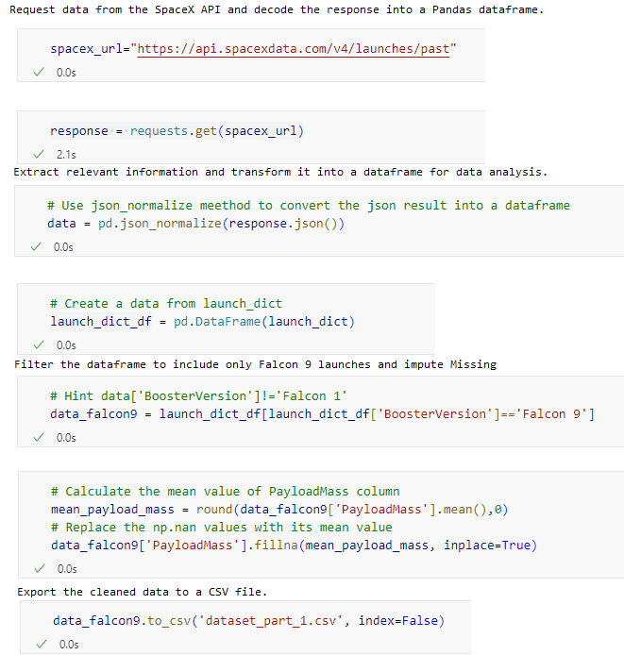
Data Collection – SpaceX API
Request data from the SpaceX API and decode the response into a Pandas dataframe.
Extract relevant information and transform it into a dataframe for data analysis.
Filter the dataframe to include only Falcon 9 launches and impute Missing Values.
Export the cleaned data to a CSV file.
Link to GitHub Notebook

Slide 9
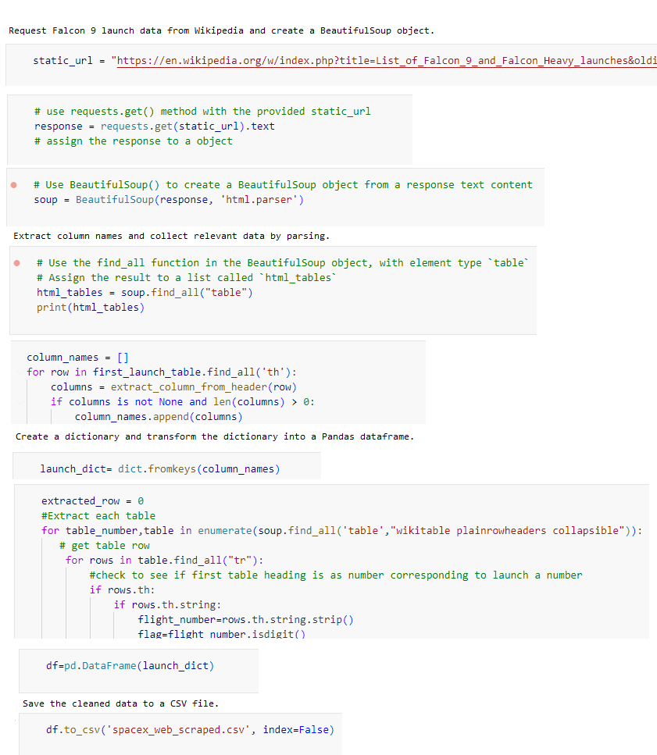
Data Collection – Web Scraping
Request Falcon 9 launch data from Wikipedia and create a BeautifulSoup object.
Extract column names and collect relevant data by parsing.
Create a dictionary and transform the dictionary into a Pandas dataframe.
Save the cleaned data to a CSV file.
Link to GitHub Notebook

Slide 10
Data Wrangling
Exploratory Data Analysis and Training Labels:
Conducted exploratory data analysis to identify training labels.
Launch Site Statistics:
Calculated the number of launches at each site.
Orbit Information:
Determined the occurrence of each orbit type.
Landing Outcome Label:
Created a landing outcome label from the ‘Outcome’ column.
Exported the results to a CSV file.
Compute the number of launches on each site
Compute the number and occurrences of each orbit
Compute the number and occurrence of mission outcome per orbit type
Create a landing outcome label from ‘Outcome’ column
Link to GitHub Notebook

Slide 11
EDA with Data Visualization
Scatter Plots are ideal for visualizing the relationship between two continuous variables.
Flight Number vs. Payload Mass: Is there’s any correlation between the flight number and payload mass. Are newer flights carrying heavier payloads?
Flight Number vs. Launch Sites: Is there’s any pattern or clustering in launch sites based on flight numbers. Are certain launch sites more common for specific flight numbers?
Payload vs. Launch Sites: How payload mass varies across different launch sites. Are there any trends or outliers?
Flight Number and Orbit Type: Are there consistent patterns on any certain flight numbers and orbit association?
Payload and Orbit Type: Does payload mass differs significantly based on the type of orbit.
Bar Chart (Success Rate of Each Orbit)
Bar charts are effective for comparing discrete categories. By plotting the success rate for each orbit type, we can easily identify which orbits have higher success rates. This information is valuable for decision-making and risk assessment.
Line Plot (Success Rate Over Time)
Line plots are excellent for showing trends over time. By plotting the success rate against dates (chronologically), we can observe how SpaceX’s success rate has evolved. Are there any notable improvements or fluctuations? This helps stakeholders track progress and identify areas for improvement.
Link to GitHub Notebook

Slide 12
EDA with SQL
Summary of SQL queries that were used:
Display unique launch site names in the space mission.
Show 5 records where launch sites start with ‘CCA.’
Retrieve the total payload mass carried by NASA (CRS) boosters.
Calculate the average payload mass carried by booster version F9 v1.1.
Identify the date of the first successful ground pad landing outcome.
List booster names with drone ship success and payload mass between 4000 and 6000.
Provide the total count of successful and failed mission outcomes.
Determine booster versions that carried the maximum payload mass using a subquery.
List failed drone ship landing outcomes, their booster versions, and launch site names for 2015.
Rank landing outcomes (Failure or Success) between June 4, 2010, and March 20, 2017, in descending order.
Link to GitHub Notebook

Slide 13
Build an Interactive Map with Folium
Markers Indicating Launch Sites
Placed a blue circle at the coordinates of NASA Johnson Space Center, displaying its name in a popup using latitude and longitude.
Marked red circles at all launch site coordinates, showing their names in popups based on latitude and longitude, using a Folium map.
Colored Markers of Launch Outcomes
Added colored markers to indicate successful launches (green) and unsuccessful launches (red) at each launch site, highlighting sites with high success rates.
Distances Between a Launch Site to Proximities
Colored lines have been added to the map, illustrating the distance between the launch site CCAFS SLC40 and its proximity to the nearest coastline, railway, highway, and city.
Link to GitHub Notebook

Slide 14
Build a Dashboard with Plotly Dash
Dropdown List with Launch Sites:
Purpose: Allows users to select either all launch sites or a specific launch site.
Use case: Provides flexibility in filtering data based on launch location.
Pie Chart Showing Successful Launches:
Purpose: Visualizes the proportion of successful and unsuccessful launches.
Use case: Helps users quickly grasp the success rate and identify trends.
Slider of Payload Mass Range:
Purpose: Enables users to filter launches based on payload mass.
Use case: Useful for exploring correlations between payload mass and launch outcomes.
Scatter Chart Showing Payload Mass vs. Success Rate by Booster Version:
Purpose: Illustrates the relationship between payload mass and launch success, considering different booster versions.
Use case: Helps users analyze how payload mass affects success rates across booster types.
Link to GitHub Notebook

Slide 15
Predictive Analysis (Classification)
Create Array
Create NumPy array from the Class column
Standardize
Standardize the data with StandardScaler. Fit and transform the data.
Split
Create GridSearchCV
Apply GridSearchCV
Apply GridSearchCV on different algorithms: logistic regression, SVC, decision tree, K-Nearest Neighbor
Calculate
Create a GridSearchCV object with cv=10 for parameter optimization
Calculate accuracy on the test data using .score() for all models
Assess
Assess the confusion matrix for all models
Identify
Identify the best model using Jaccard_Score, F1_Score and Accuracy
Split the data using train_test_split
Scikit-learn is Machine Learning library that was used for predictive analysis.
Link to GitHub Notebook

Slide 16
Results
The Exploratory Data Analysis has shown us that successful landing outcomes are somewhat correlated with flight number. It was also apparent that successful landing outcomes have had a significant increase since the year 2015.
KSC LC-39A has the highest success rate among landing sites.
Orbits ES-L1, GEO, HEO and SSO have a 100% success rate.
The Visual Analytics shows that all launch sites are located near the coast line. Perhaps, this makes it easier to test rocket landings in the water.
Launch sites are far enough away from anything a failed launch can damage (city, highway, railway), while still close enough to bring people and material to support launch activities.
Decision Tree model is the best predictive model for the dataset. The machine learning were able to predict the landing success of rockets with an accuracy score of 83.33%.

Slide 17

Section 2

Slide 18
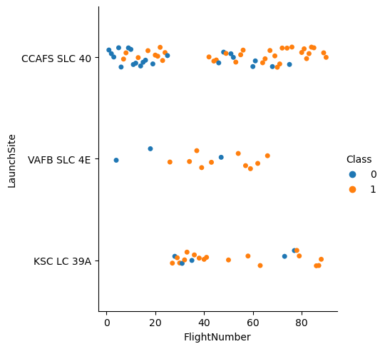
Flight Number vs. Launch Site
Earlier flights, represented by blue, exhibited a lower success rate, while later flights (orange) showed higher success rates. Approximately half of the launches originated from CCAFS SLC 40, whereas VAFB SLC 4E and KSC LC 39A had notably higher success rates.
Overall, we can infer that newer launches tend to achieve greater success.

Slide 19
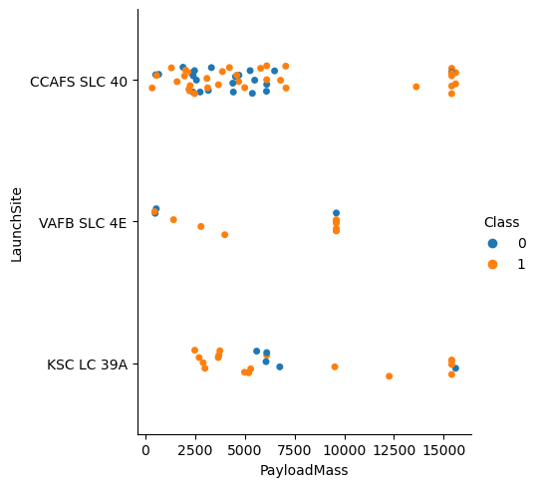
Payload vs. Launch Site
Generally, as payload mass (measured in kilograms) increases, the success rate of launches tends to rise.
Notably, most launches with a payload exceeding 7,000 kg achieved success.
Additionally, KSC LC 39A boasts a perfect success rate for launches with payloads below 5,500 kg, while VAFB SLC 4E has yet to launch payloads greater than approximately 10,000 kg.

Slide 20
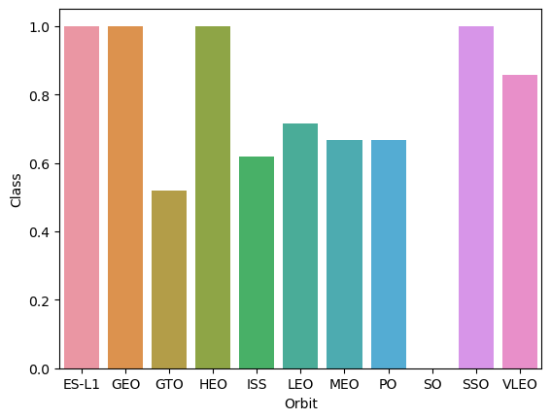
Success Rate vs. Orbit Type
Missions to ES-L1, GEO, HEO, and SSO achieved a remarkable 100% success rate.
Launches targeting GTO, ISS, LEO, MEO, and PO fell within the 50%-80% success range.
Unfortunately, launches to SO (specific orbit) had a 0% success rate.

Slide 21
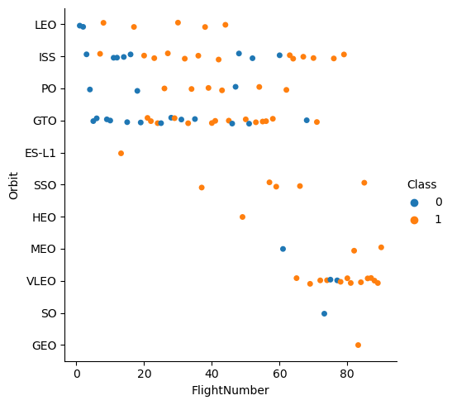
Flight Number vs. Orbit Type
The success rate tends to increase as the number of flights for each orbit grows.
This trend is particularly evident in the Low Earth Orbit (LEO).
However, the Geostationary Transfer Orbit (GTO) does not conform to this pattern.

Slide 22
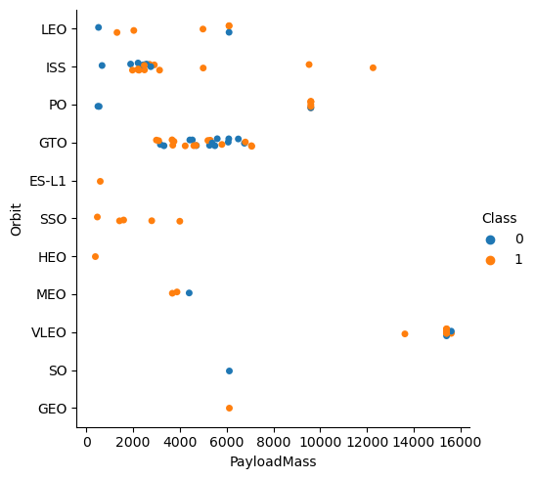
Payload vs. Orbit Type
Heavy payloads tend to perform well in Low Earth Orbit (LEO), International Space Station (ISS), and Polar Orbit (PO). However, the Geostationary Transfer Orbit (GTO) shows mixed success rates when handling heavier payloads.

Slide 23
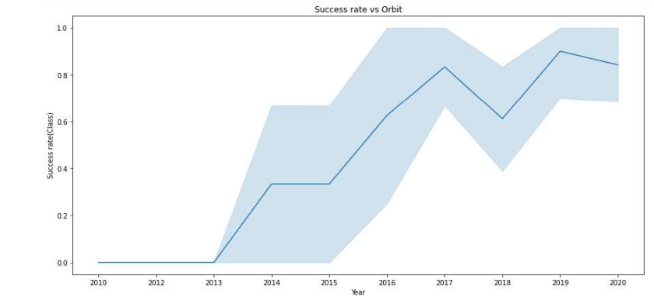
Launch Success Yearly Trend
The success rate showed improvement between 2013 and 2017, as well as from 2018 to 2019. However, there was a decline in success rates from 2017 to 2018 and again from 2019 to 2020. Overall, since 2013, the success rate has seen positive progress.

Slide 24
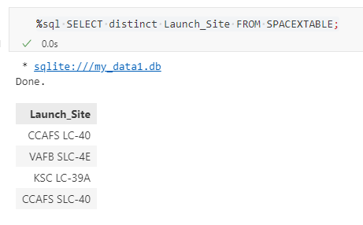
All Launch Site Names
There are only 4 Launch Sites where different rocket landings where attempted.

Slide 25
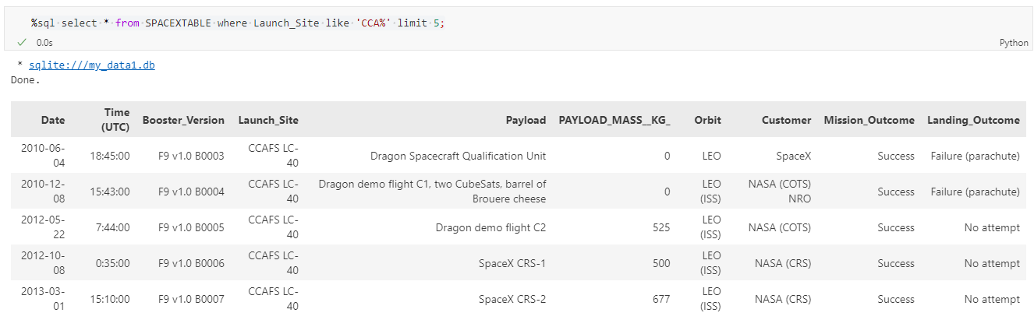
Launch Site Names Begin with 'CCA'
These are 5 records where launch sites begin with the letters 'CCA’.
As we can see, there are other organizations besides Space X that were testing their rockets

Slide 26
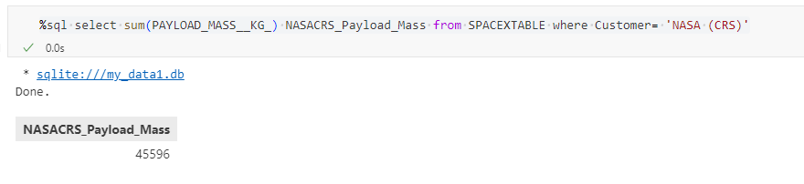
Total Payload Mass
The total payload mass carried by boosters launched by NASA (CRS) is 45,596 kg

Slide 27
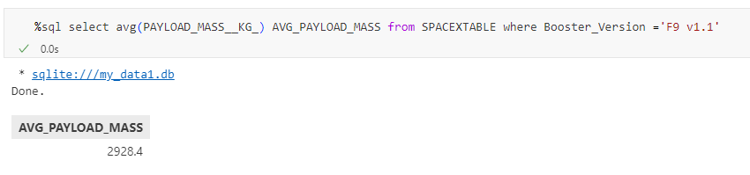
Average Payload Mass by F9 v1.1
The query calculates the average payload mass carried into space for the ‘F9 v1.1’ booster version, resulting in approximately 2928.4 kg

Slide 28
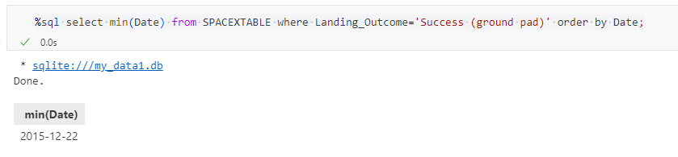
First Successful Ground Landing Date
The SQL query selects the minimum date (min(Date)) from a table named ‘SPACEXTABLE’ where the ‘Landing_Outcome’ is ‘Success (ground pad)’.
The result indicates that the earliest successful ground pad landing occurred on December 12,2022.
This information could be relevant for analyzing the history of space missions, particularly those related to SpaceX and their landing outcomes over time.

Slide 29
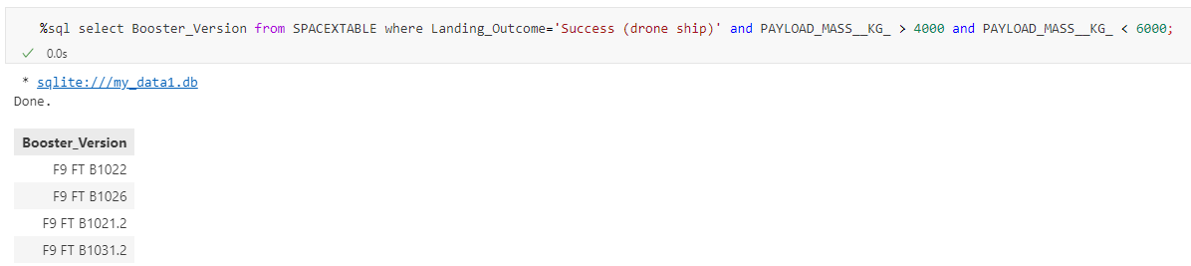
Successful Drone Ship Landing with Payload between 4000 and 6000
The SQL query results indicate that there are four instances where the ‘BoosterVersion’ had a landing outcome of ‘Success (drone ship)’ with the payload mass being greater than or equal to 4000 kg and less than 6000 kg. This information could be relevant for analyzing the performance of different booster versions under specified conditions.

Slide 30
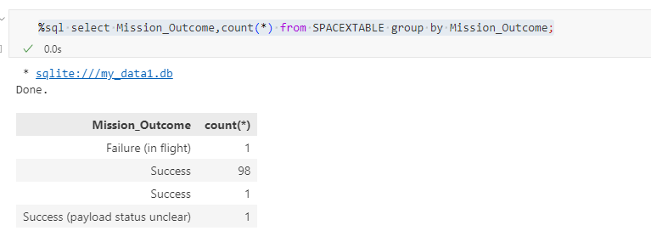
Total Number of Successful and Failure Mission Outcomes
The SQL query results indicate that there was one occurrence of “Failure (in flight),” 98 occurrences of “Success,” and one occurrence of “Success (payload status unclear)” in the dataset.

Slide 31
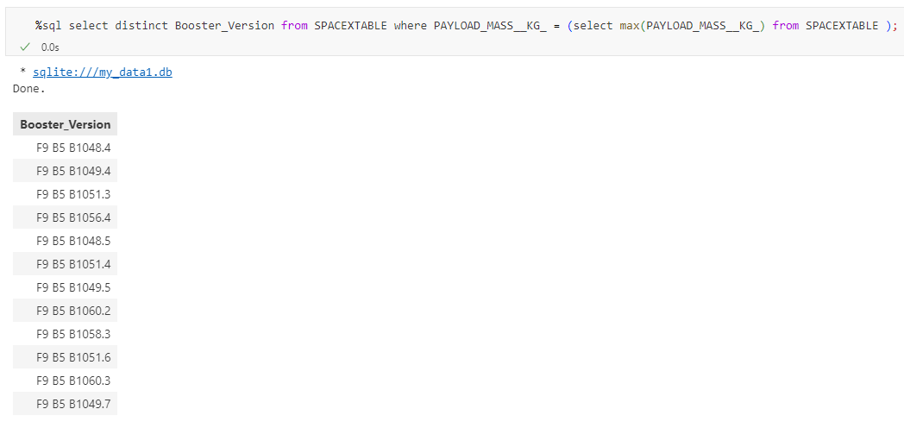
Boosters Carried Maximum Payload
It shows that 12 unique boosters have carried the maximum payload mass of 15600 kg.

Slide 32
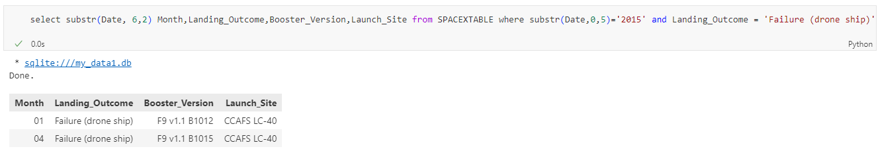
2015 Launch Records
There were 2 failed landing_outcomes in drone ship for in year 2015.
We used a combinations of the WHERE clause, LIKE, AND, and BETWEEN conditions to filter for failed landing outcomes in drone ship, their booster versions, and launch site names for year 2015

Slide 33
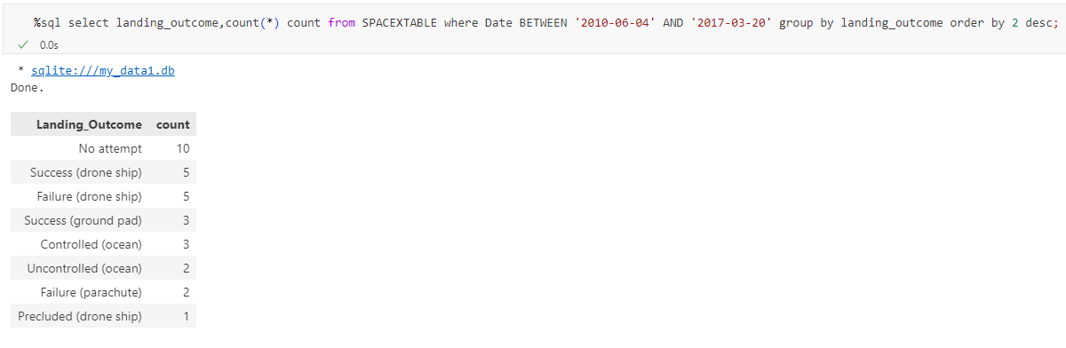
Rank Landing Outcomes Between 2010-06-04 and 2017-03-20
We selected Landing outcomes and the COUNT of landing outcomes from the data and used the WHERE clause to filter for landing outcomes BETWEEN 2010-06-04 to 2010-03-20.
We applied the GROUP BY clause to group the landing outcomes and the ORDER BY clause to order the grouped landing outcome in descending order.

Slide 34

Section 3

Slide 35
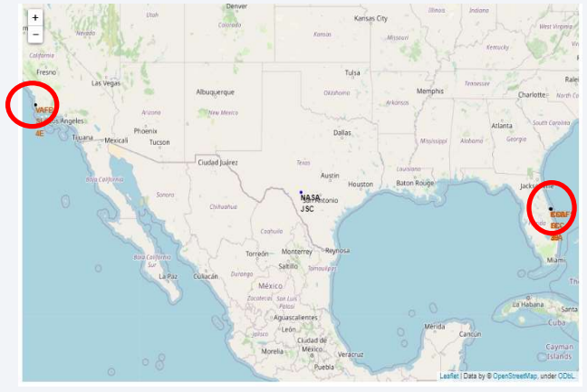
Launch Site Locations
Launching rockets from sites near the equator, all of which are in very close proximity to the coast and a couple of thousand kilometers away from the equator line, benefits from Earth’s rotation.
This makes it easier to achieve an equatorial orbit, and the additional natural boost due to Earth’s rotational speed helps reduce costs by minimizing the need for extra fuel and boosters.

Slide 36
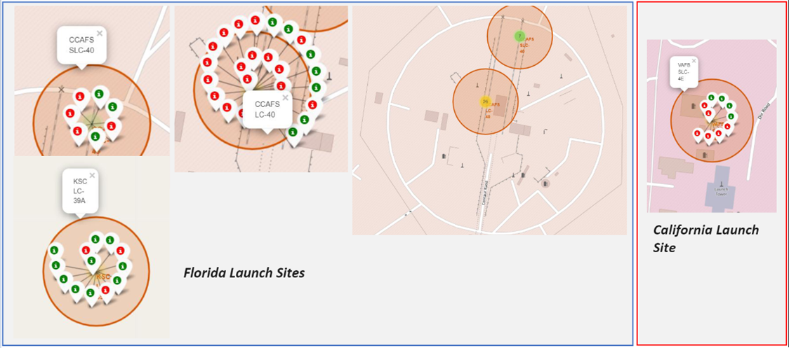
Success Rate of Rocket Launches
The successful launches are represented by a green marker while the red marker represents failed rocket launches.
Launch site CCAFS SLC-40 has a 3/7 success rate (42.9%)

Slide 37
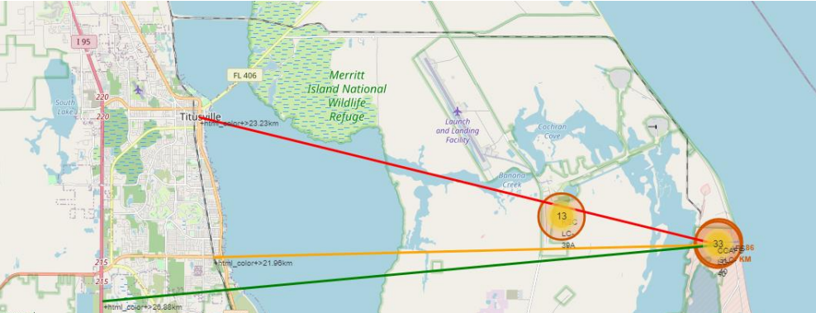
Distance to Proximities
The image depicts a map with distances from a central point labeled “CCAFS SLC-40” to various proximities. Specifically, it shows the following distances:
.86 km from the nearest coastline
21.96 km from the nearest railway
23.23 km from the nearest city
26.88 km from the nearest highway
These distances are visually represented on the map, connecting CCAFS SLC-40 to the respective points of interest. Such information could be valuable for logistical planning or assessing accessibility.

Slide 38
Distance to Proximities
• Coasts: help ensure that spent stages dropped along the launch path or
failed launches don't fall on people or property.
• Safety / Security: needs to be an exclusion zone around the launch site to
keep unauthorized people away and keep people safe.
• Transportation/Infrastructure and Cities: need to be away from anything a
failed launch can damage, but still close enough to roads/rails/docks to be
able to bring people and material to or from it in support of launch activities

Slide 39

Section 4

Slide 40
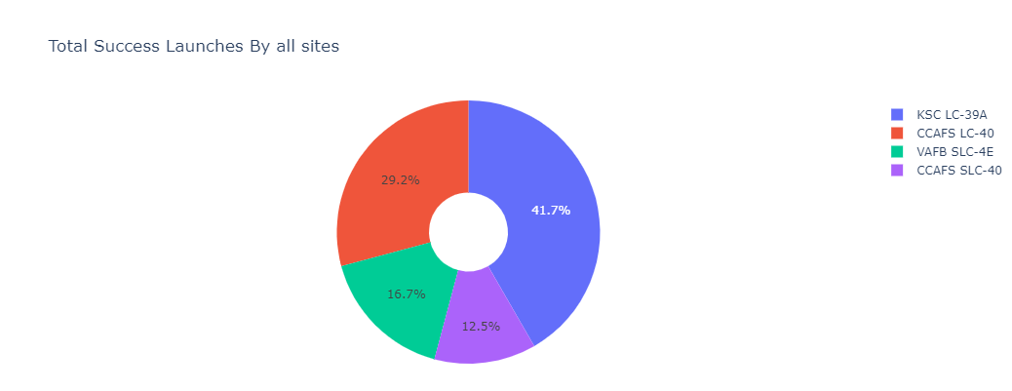
Successful Launches by Site
KSC LC-39A has the most successful launches amongst launch sites (41.2%)

Slide 41
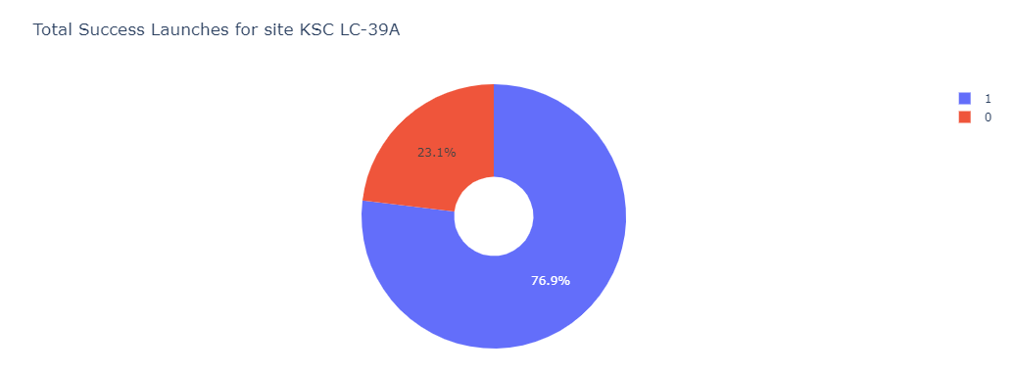
Total Successful Launches for Site KSC LC-39A
76.9% of the total launches at site KSC LC-39A were successful
(10 successful launches and 3 failed launches)
This is the highest success rate of all the different launch sites.

Slide 42
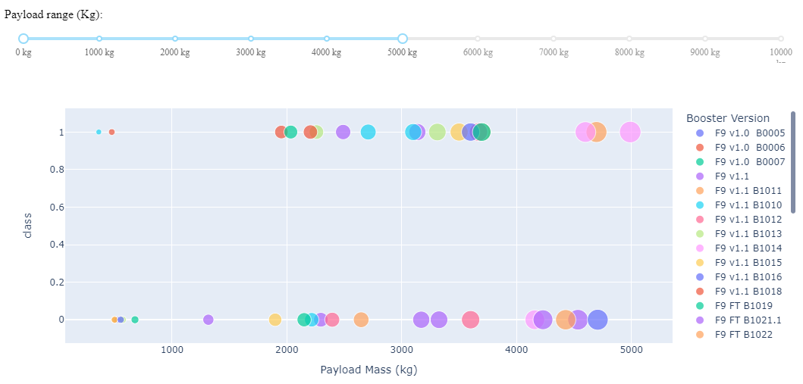
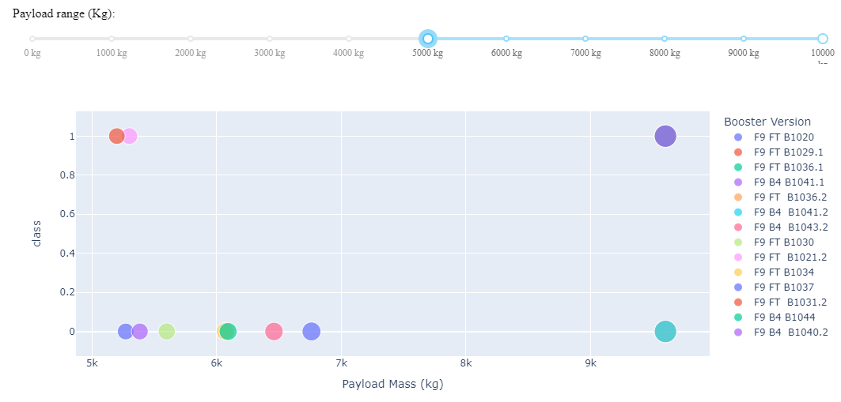
Payload Mass and Success
Low Weighted Payload 0kg – 5000kg
Heavy Weighted Payload 5000kg – 10000kg
The success rates for low weighted payloads is higher than the heavy weighted payloads

Slide 43

Section 5

Slide 44
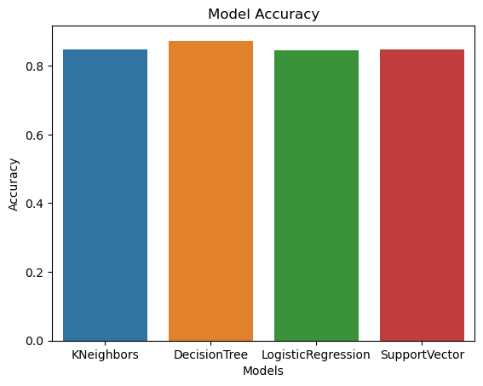

Classification Accuracy
Accuracy
All the models achieved similar performance levels with identical scores and accuracy. This consistency is likely attributed to the small dataset. However, the Decision Tree model exhibited slightly better performance when considering the .best_score_, which represents the average across all cross-validation folds for a specific parameter combination.
After selecting the best hyperparameters for the decision tree classifier using the validation data, we achieved 83.33% accuracy on the test data.

Slide 45

Confusion Matrix
The decision tree classifier’s confusion matrix indicates that it effectively distinguishes between various classes. However, a notable issue arises with false positives—instances where unsuccessful landings are incorrectly classified as successful by the model.
• Precision = TP / (TP + FP) = 12 / 15 = .80
• Recall = TP / (TP + FN) = 12 / 12 = 1
• F1 Score = 2 * (Precision * Recall) / (Precision + Recall) = 2 * (.8 * 1) / (.8 + 1) = .89
• Accuracy = (TP + TN) / (TP + TN + FP + FN) = .833

Slide 46
Conclusions
To compete with SpaceX, let’s delve into an overview of their successful methods.
Their launch sites are strategically located near coastlines, away from urban areas, allowing them to test rocket landings with minimal interference.
Most of these launch sites are positioned near the equator, leveraging Earth’s rotational speed to reduce the need for extra fuel and boosters.
Across all launch sites, higher payload masses correlate with higher success rates.
Site KSC LC-39A boasts the highest launch success rate among all SpaceX sites.
Over time, SpaceX’s launch success rates improve as they refine their processes.
Orbits GEO, HEO, SSO, and ES-L1 exhibit the best success rates.
The data collected from these observations was used to train a machine learning model, achieving an 83.33% accuracy in predicting rocket landing outcomes.

Slide 47


